Slide 1
How did the Cold war develop?
Lobj: to understand how the Cold War developed between 1949 – 1955.

Slide 2
Checklist & highlighter
Reward postcards

Slide 3
RESULTS OF THE BLOCKADE
The crisis was costly – in human and financial terms
79 GB & US pilots were killed in accidents
It did end ill feeling between Germany & the USA (now friendly!)
Dashed all hopes of uniting Berlin

Slide 4
RESULTS OF THE BLOCKADE 2
1949 – the Western Zones came together as West Germany
Known as Federal Republic of Germany
With free elections & democratic Govt
USSR responded – East Germany was changed to:
German Democratic Republic – which had Communist Govt (1990)

Slide 5
NATO
The Berlin blockade scared the British
10 days after it started the Brits opened talks with the USA
These discussions led in 1949 to the foundation of the North Atlantic Treaty Organisation (NATO)

Slide 6
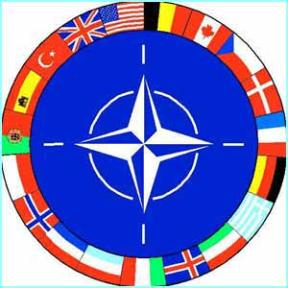
NATO
MEMBERS INC: USA, Canada, GB, France, Belgium, the Netherlands, Iceland, Luxembourg, Italy, Norway, Denmark & Portugal.
1952 – Greece & Turkey joined
1955 – West Germany joined
All members agreed – if one of them was attacked – they would all protect that country.

Slide 7
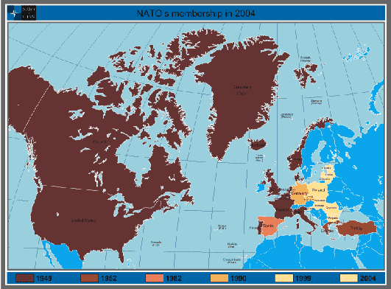

Slide 8
NATO
NATO – meant a permanent presence in Europe for the US army.
NATO command – in Paris
Stalin saw NATO was an act of war and speeded up his own nuclear deterrent against the West – a Soviet Atomic Bomb (1950)

Slide 10
WAR IN KOREA
The Japanese had occupied Korea from 1910 – 1945
After WW2 the country was divided in two (38th Parallel)
Soviet forces occupied the North
US forces occupied the South
This division was meant to be temporary.

Slide 11
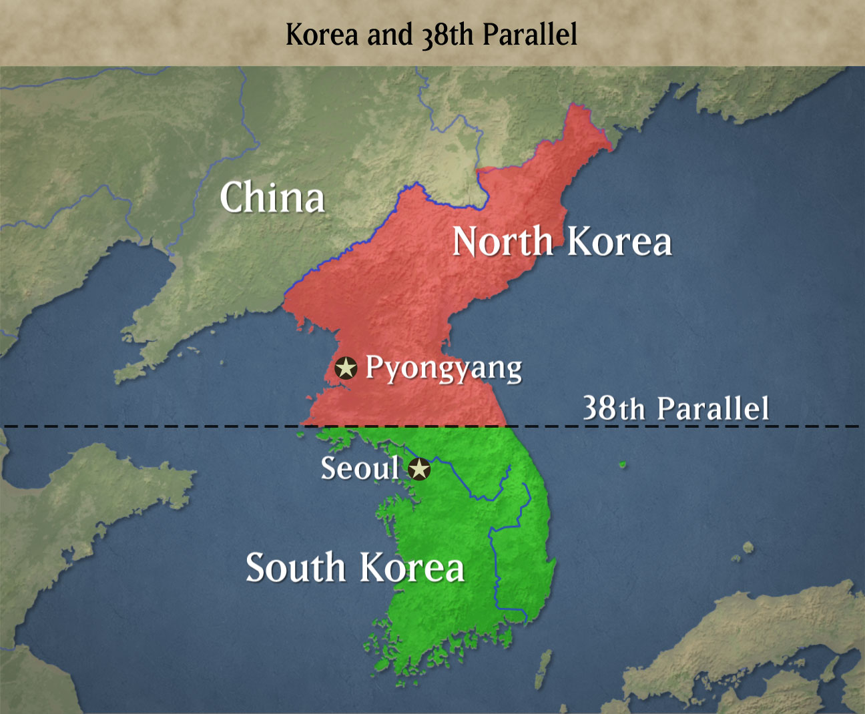

Slide 12
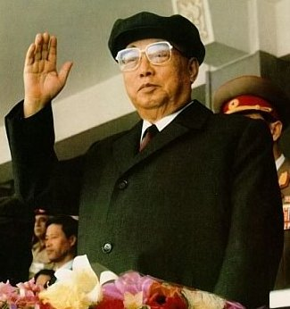
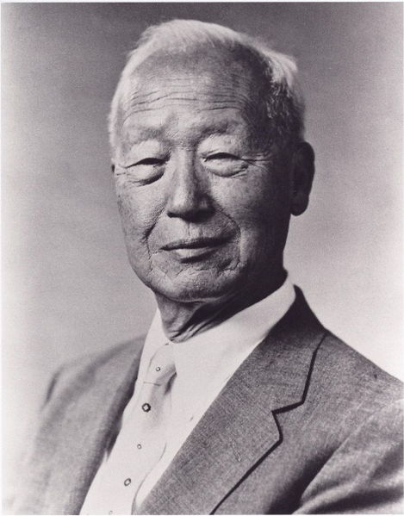
In the North – a communist state was set up under Kim il Sung
In the south there were elections = an anti communist military Govt was set up - led by Syngman Rhee
Each side claimed to be the Govt of ALL Korea

Slide 13
WHY DID THE USA GET INVOLVED?
CONTAINMENT - push back Communism
DOMINO THEORY – if South Korea fall, Japan and others could be next

Slide 14
BACKGROUND TO WAR
1949 – NATO formed – US gave aid to Japan
North Korea asked Stalin’s permission to attack the South
Gave USA a headache & trouble
He gave the North aid & military equipment – but never got involved directly
JUNE 1950 – The North invaded the South = WAR

Slide 15
1. Initial North Successes
North Korean Army = NKPA
North was successful at first – most of the south fell
The South asked the U.N for helped – they did – as USSR was boycotting meetings & China wasn’t allowed to join

Slide 17
2. The NKPA is driven back
16 nations headed by the USA first went
Later the number doubled to 32 countries
The North were driven back to China and their resistance collapsed

Slide 19
3. China intervenes
In Nov 1950 China sent 200,000 ‘volunteers’ to help North Korea
The South were pushed back beyond the 38th parallel

Slide 21
4. Stalemate
The USA poured more men in and pushed the Chinese back to the 38th parallel (the original starting point)
The rest of the war was stalemate
A ceasefire was agreed in 1953

Slide 23
The impact of the Korean War
1954 – SEATO set up – an Asian version of NATO (South East Asian Treaty Organisation)
Aim = to contain Communism in the far east
Korea – devastated – one in ten died
Korea a success for United Nations - stronger than LON & prepared to stand up & fight

Slide 24
The impact of the Korean War 2.
USA - saw Korea as a success (stopped Communism)
Needed to stop other countries – next was VIETNAM
Korean War also showed China was no longer a weak nation & were prepared to stand up to the West.

