Slide 1
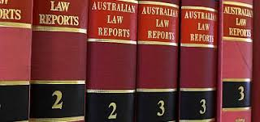
Sources of Law
Common Law

Slide 2
Before Henry II
Before the time of Henry II (1154 – 1189) local customs AND local laws varied from place to place
There was no record of what decisions had been made, in what circumstances
There was no standard framework within which the law operated
The legal system was therefore arbitrarily imposed and applied

Slide 3
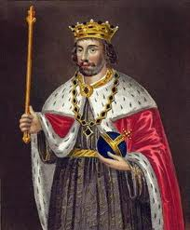
What did Henry II do?
Established a centralised administration of the King’s law and directed that Judges travel “on circuit” to deal with disputes
The Judges developed a COMMON set of procedures and rules which clerks who worked in the Court, and lawyers who appeared, started writing down
This written body of laws became known as “Common Law” and were the beginnings of the doctrine of precedent.

Slide 4
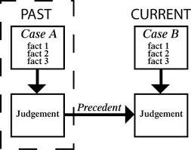
Doctrine of Precedent
The Doctrine of Precedent specifies that a court should apply the rulings of previous cases in situations where the facts are the same.
More specifically, a court is bound to do so if the previous case was tried in a higher court, in the same hierarchy (ie, District Court of NSW must follow rulings of the Supreme Court of NSW).
Because of the Doctrine of Precedent, judges decisions thus become law which future judges must follow. That is what is referred to as judge-made law, or common law (as a source of law).

Slide 5
Equity
The courts of common law became limited by the formalism arising out of the use of writs and forms of action.
Despite the perception that judges in the common law system act freely, the historical reality was that it took decades for new forms of action to be judicially accepted.
Even these new forms were extremely formalistic and form-bound with no room for judicial interpretation
A body of case law gradually evolved within the Court of the Chancery addressing situations in which there was no form of action or the remedy at law was insufficient.
The legal institution of equity developed as a result of this along the lines as articulated by Aristotle: “[T]his is the essential nature of the equitable: it is a rectification of law where law is defective because of its generality: it is because there are some cases for which it is impossible to lay down a law, so that a special ordinance becomes necessary.”

Slide 6
The Role of Equity
Equitable Courts seek to ensure that those wronged are not inequitably dealt with under the common law precedents and formalities
Equitable matters were dealt with on the PARTICULAR set of facts AND were available ONLY when common law remedies were inadequate or unjust.
The two systems (Common Law and Equity) were fused in the 13th Century.
In modern times equitable PROCESSES are incorporated into our legal system AND inequitable results may be appealed to higher courts.

Slide 7
More About the Doctrine of Precedent
A precedent is BINDING if:
The facts of the past and current case are identical / similar; AND
A higher Court, in the SAME Court hierarchy, has decided the case
A precedent is PERSUASIVE if:
A Court has ruled on a case BUT not in the same Court hierarchy OR at the same level in the hierarchy as the current Court
When a Court applies a precedent it is said to be applying the principle of stare decisis (to stand by a decision)

Slide 8
Precedent can be
Applied – when the precedent is followed
Overturned – when a precedent is overruled
Distinguished – when a precedent is NOT applied because the facts of the current case distinguish/differentiate from the previous case
Expanded/Limited by Courts of the same authority
NB “LEADING CASE”

Slide 9
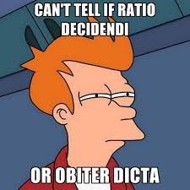
A Court Makes a Ruling
When a Court makes a ruling there are TWO components to differentiate
Ratio Decidendi:
The reason(s) for a Court’s decision which may represent a precedent for a Court in the future
Obiter Dictum:
“Sayings along the way” or “commentary on ancillary matters” that can only represent persuasive observations to any Court in the future.

