Slide 1
Procedural Fairness
Natural Justice

Slide 2
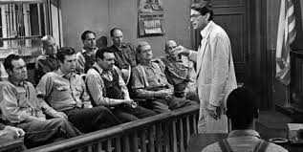
What is Procedural Fairness?
Procedural fairness strives to ENSURE that the LEGAL SYSTEM provides a fair and just PROCESS for ALL individuals

Slide 3
What Characterises procedural fairness?
The right to participate in legal proceedings relevant to them
The right to know the nature of the charges
The right to present evidence at a hearing
The right to have the matter determined in a Court without bias
The right to test the evidence presented
The right to have the matter heard without reference to any previous convictions or accusations

Slide 4
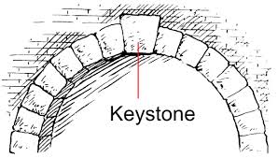
The Rule of Law
The rule of law is the key principle or keystone of legal systems in a democratic society
The rule of law eliminates the exercise of power arbitrarily.
Arbitrary power may be defined as making decisions WITHOUT reference to the law

Slide 5
Characteristics of a Society that Operates Under the Rule of Law
An independent judiciary
Checks, controls and accountability of enforcement agencies
An individual’s right NOT to incriminate themselves
The right to conduct a legal defence without interference by the prosecution
Practical application of the elements of procedural fairness
Prospective, not retrospective, criminal laws
Governmental power bound by Constitutions
Human rights, including freedom of speech and freedom of the press

Slide 6
What Are Alternatives to the Rule of Law?
Anarchy
a state of disorder due to absence or non-recognition of authority or other controlling systems.
Tyranny (“Police States”)
an oppressive government or rulership unfettered by constiutional limits and normally arbitrary in their justice system

