Slide 1
Why did the USA & USSR become rivals?
Lo – to consider effects of Hiroshima & Nagasaki.
`

Slide 2
1945
6th August – the atomic bomb kills 78,000 Japanese people in Hiroshima
9th – 74,000 killed in Nagasaki
Stalin was angry that Truman had not told him at Potsdam about the atom bomb
Believed it was a betrayal of trust

Slide 3
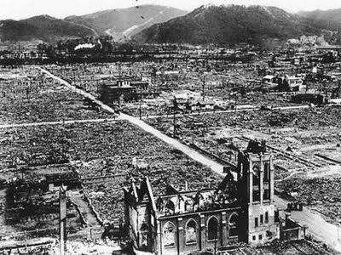
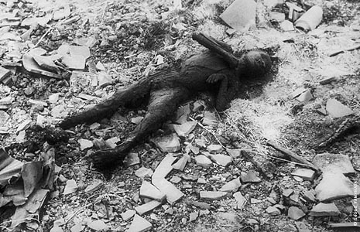
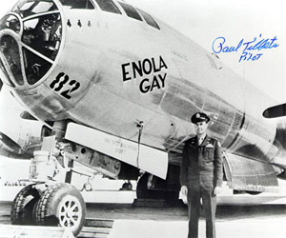

Slide 4
By 1949 the USSR had developed its own bomb
Meant ‘could’ be nuclear destruction – instead there was a series of tense confrontations
Could argue the nuclear bomb stopped the Cold War becoming hot (M.A.D)

Slide 6
THE USSR & EASTERN EUROPE – The Iron Curtain
End of WW2 the Soviets liberated countries from the Nazis
Replaced it with Soviet occupation
Communist Govts loyal to Stalin took power in Bulgaria, Poland, Hungary & Romania

Slide 7
Stalin also took control of the police, army & radio stations in these areas
He arrested & murdered political opponents
These moves alarmed Churchill. In March 1946 (Fulton,USA) he described the division between East & West as an ‘Iron Curtain’

Slide 8
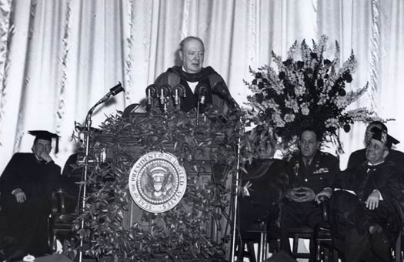

Slide 9
THE IRON CURTAIN
On one side was the one party, communist states of the East
On the other, were the capitalist democracies of the West.
Churchill wanted to convince the US to prevent the spread of Communism
Stalin claimed this speech was a declaration of war.

Slide 10
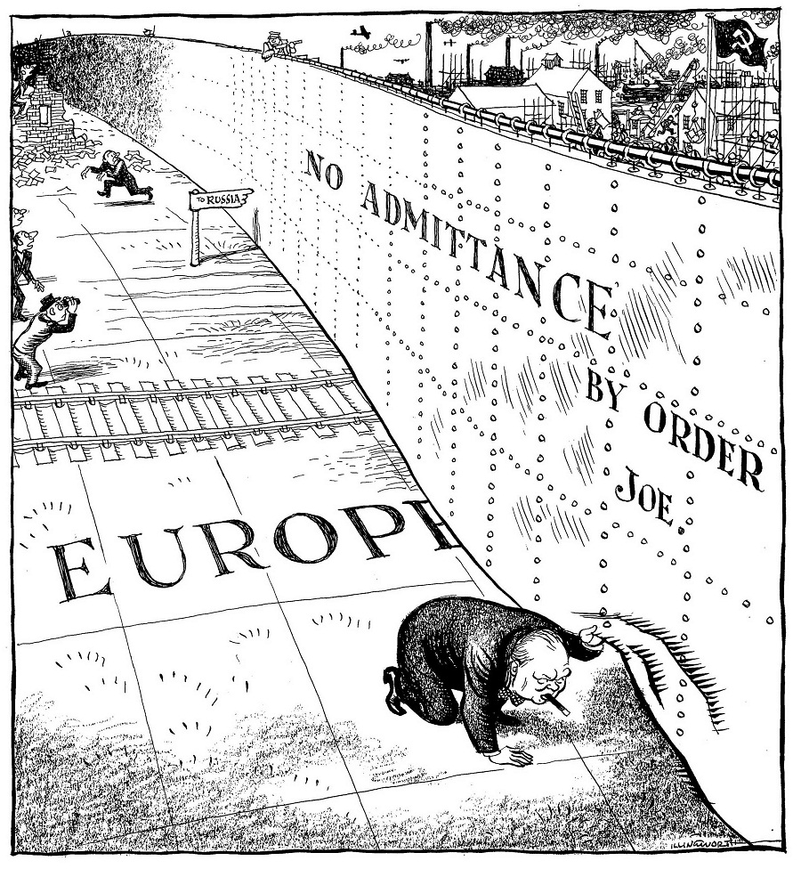

Slide 13
THE IRON CURTAIN
http://www.youtube.com/watch?v=jvax5VUvjWQ

Slide 14
THE TRUMAN DOCTRINE
1947 – Communists threatening to take Greece & Turkey (GB could no longer help Greece)
March 1947 – President Truman declared he would help any nation threatened Communism (Truman doctrine)
He said the countries of Eastern Europe had been forced into Communism
Also that it was the USA’s duty to protect democratic countries
They gave Greece & Turkey $400 million in aid – which helped defeat the Communists

Slide 16
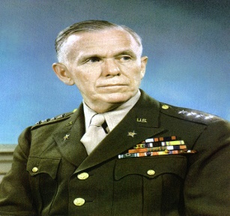
THE MARSHALL PLAN
1947 – general George Marshall visited Europe
Came up with the Marshall plan.
The aim was to help Europe recover from WW2 and resist communism.
Also meant a strong Europe could trade with the USA again.

Slide 17
THE MARSHALL PLAN
At first congress hesitated
Feb 1948 – Stalinists seized power in Czechoslovakia
Congress approved Marshall aid on 31st March 1948.

Slide 18
Marshall Aid
Set up a fund of $15 billion
16 nations asked for help – GB & West Germany included
Aid often arrived in the form of goods – machinery & fertilisers
Industrial production increased in Western Europe (by 25%) and communist influence fell in France & Italy

Slide 20
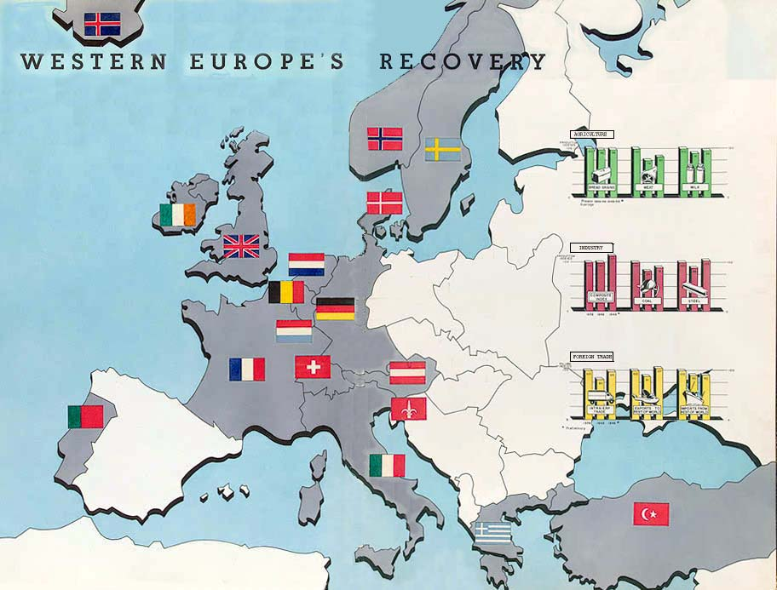

Slide 21
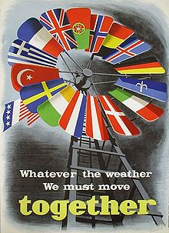

Slide 22
DOLLAR IMPERIALISM
Stalin called the Marshall plan “Dollar imperialism”
He claimed the USA was trying to build an Empire
His fear and suspicion intensified divisions in Europe

Slide 23
COMINFORM
1947 – communist leaders all over the world were summoned to a conference in Warsaw
Cominform was created – Communist Information Bureau
Was designed to spread & protect communism from US agression

Slide 24
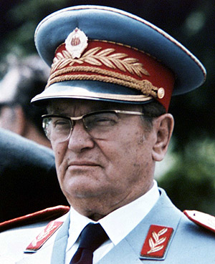
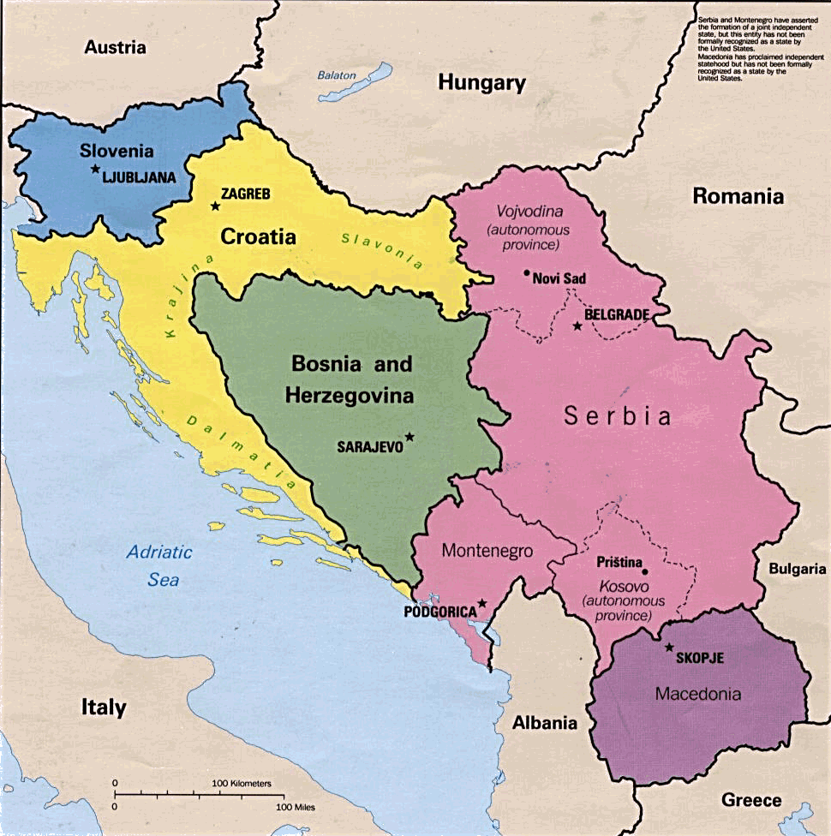
1948 – Stalin ordered Cominform to expel Tito (leader of Yugoslavia – because he would not do what he was told)
Stalin wanted control & no opposition

Slide 25
COMECON
1949 – USSR introduced the Molotov Plan
This established the Council for Mutual Economic Assistance (Comecon)
This linked the USSR with Bulgaria, Czechoslovakia, Hungary, Poland, Romania & East Germany
US – saw Comecon & Cominform as serious threats – relations got worse!

