Slide 1
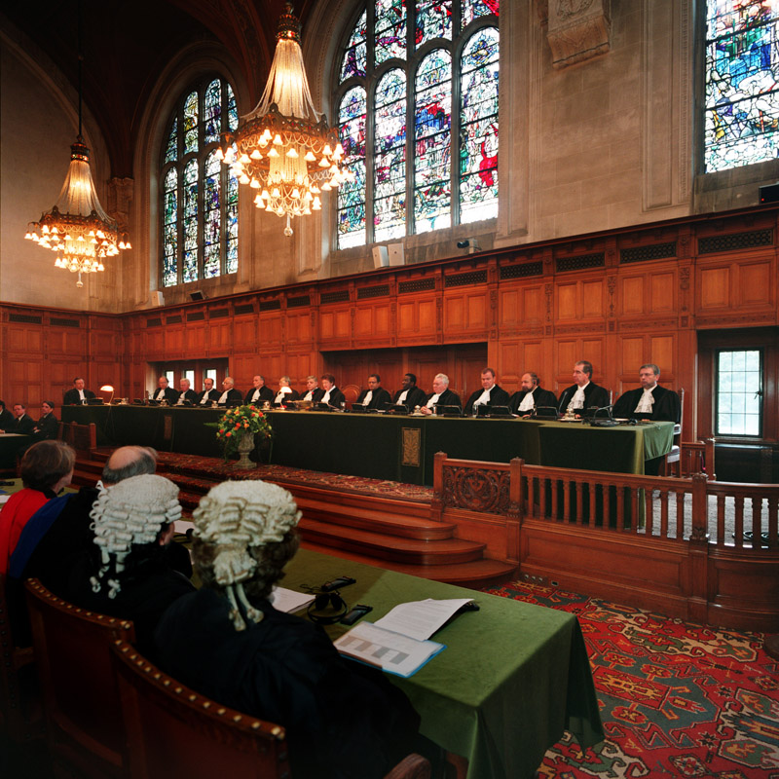
International Crime

Slide 2
How could we define “International Crime”
Any thoughts?
Some points to consider:
Jurisdiction – how can nations/individuals/communities prosecute crimes originating in different jurisdictions?
How can nations prosecute other nations (eg whaling, East Timor v Australia)

Slide 3
International Crime Defined
Any crime with international origin or consequences
International crimes involve some crossing of international borders in the commission or planning of the crime OR
A breach of criminal standards set by the international community in the form of international treaties or conventions OR international customary of law

Slide 4
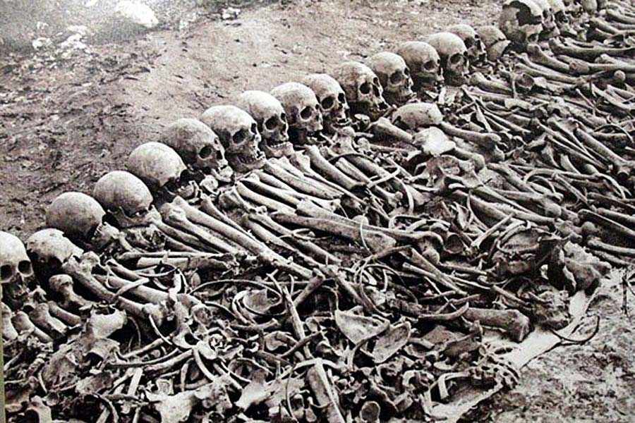
Categories Of International Crime
Crimes against the international community
Transnational crime

Slide 5
Crimes Against the International Community
Crimes that are recognised by the international community as being of universal concern
Crimes that are deemed so serious
that they are condemned
by the majority of the international
community AND may be punishable
internationally

Slide 6
Crimes Against the International Community - Examples
Genocide
War crimes
Piracy
Aircraft hijacking
Slave trading
Infantile abuse
But what about?
Environmental destruction
Failure to limit global warming?
Trading in organs, stem cells
Euthanasia

Slide 7
Transnational Crime – Examples
People smuggling
International fraud
Computer crimes
Terrorism
Child pornography

Slide 8
What is the importance of categorising a crime as “international”
International condemnation of a crime creates a right for other nations to prosecute under a claim of “universal jurisdiction”
This means that criminals will not escape by fleeing to other jurisdictions or because they are still in power in the country in which the crime was committed

Slide 9
Responses to International Crime
The response is either Domestic or International
Domestic responses include:
Ratification of the Rome Statute (made all the crimes listed in the Rome Statute offences in Australia)
Crimes (Child Sex Tourism) Amendment Act 1994 (Cth)
Australian Federal Police, Australian Customs and Border Protection Service

Slide 10
International Responses
International co-operation eg Moratoriums on the export of certain materials to certain nations
The establishment of various international tribunals eg the International Court of Criminal Justice
International co-operation and intelligence sharing
Interpol (International Criminal Police Organisation)
Various International Conventions, Treaties etc
War

Slide 11
Hot Topics In International Crime
Child soldiers
Who is a terrorist? From whom’s perspective
Fundamentalist Islamic rights with respect to women
Harvesting of organs / stem cells etc
Climate change

Slide 12
Effectiveness of Measures
Discuss

