Slide 1
KOREA
THE COLD WAR BEYOND EUROPE

Slide 2
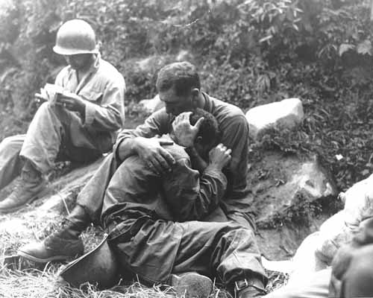
THE KOREAN WAR
A grief stricken American infantryman whose buddy has been killed in action is comforted by another soldier. In the background a corpsman methodically fills out casualty tags, Haktong-ni area, Korea. August 28, 1950. Sfc. Al Chang. (Army)

Slide 3
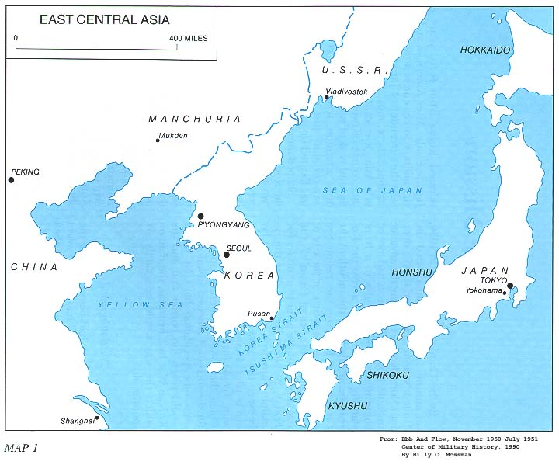
MAPS

Slide 4
TIMELINE
1945 – Korea controlled by Japan
Soviets occupied the NORTH, America the SOUTH
The two halves were divided by the 38th Parallel
1947 – elections held in the South supported by the US; The North had its own govt. backed by the Soviets
Each government claimed to be the rightful rulers of Korea
Each side was supported by the respective superpower even though they withdrew troops in 1948.

Slide 5
TIMELINE
1949 – China became Communist – supported N Korea
1950 – N Korea invaded S Korea
Sept 1950 – UN troops into S Korea at INCHON
N Koreans pushed back into N Korea
Oct 1950 Chinese invaded N Korea
UN troops pushed back to S Korea
1950-51 – STALEMATE around 38th Parallel
April 1951 – MacArthur removed from position – replaced by General Omar Bradley

Slide 6
TIMELINE
Fighting continued until 1952
1952 – Truman replaced by Eisenhower
1953 – Stalin died
July 1953 - Armistice signed

Slide 7
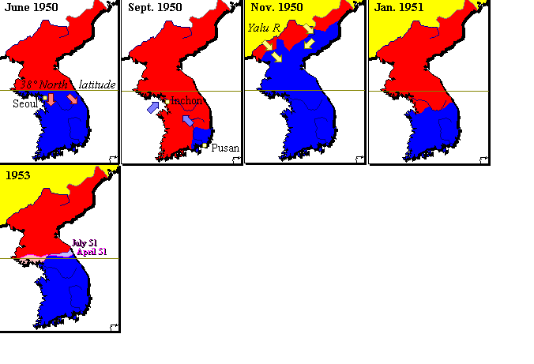

Slide 8
The Key Players
Truman
Syngman Rhee – SK
UN
MacArthur
Bradley
Kim Il Sung - NK
Mao Tse Tung
Stalin

Slide 9
WHO WON????
S KOREA REMAINED ‘FREE’
Containment had worked
Korea badly damaged
The human cost
Still two separate states today
Still US troops in Korea

Slide 10
THE COST IN HUMAN LIFE

Slide 11
By 1950 had Containment worked???
Most Americans agreed with containing communism
Some wanted a more aggressive policy like MacArthur
More alliances were set up that were anti-Communist

Slide 12
What do you think?
Did the West win?
What were the after war events that support your position?
What is Australia’s relationship now with Korea?
What is Korea like now?

